Slide 1
BASIC CONCEPTS OF INCOME TAX

Slide 2
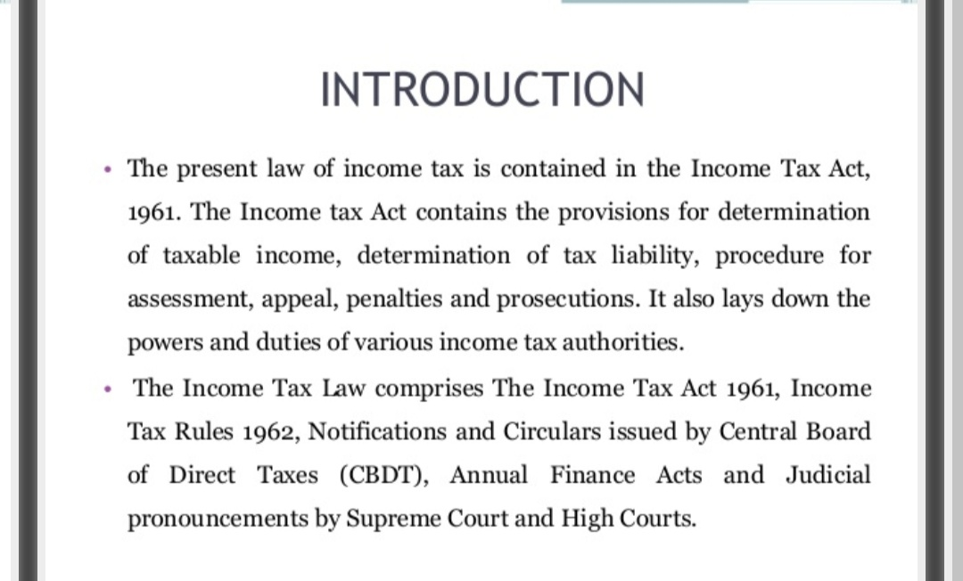

Slide 4
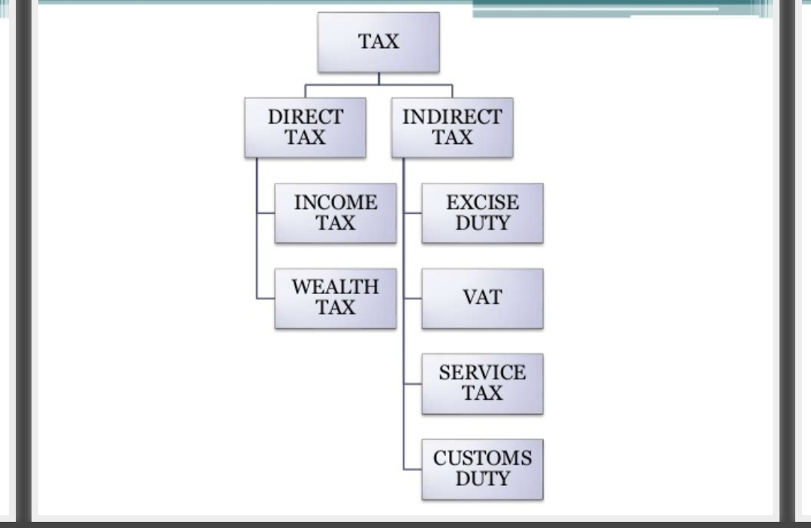

Slide 7
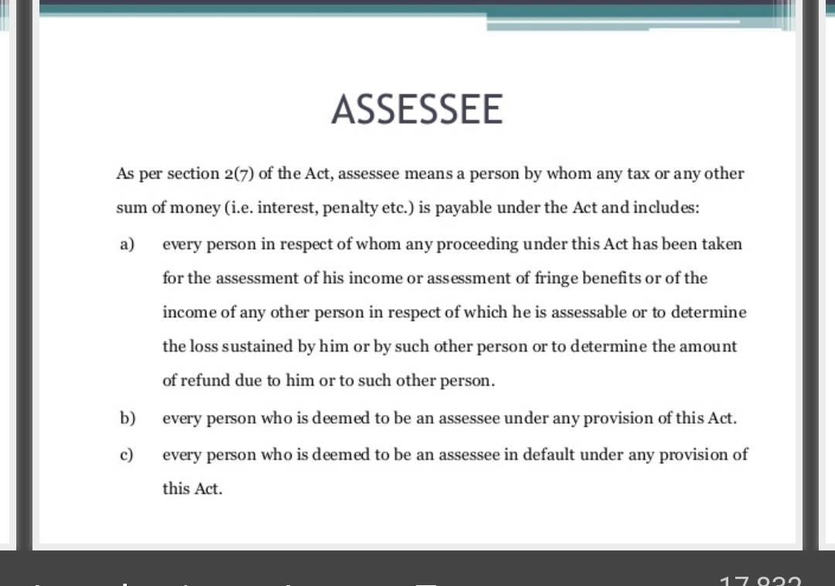

Slide 9
